Slide 1
Showcasing the Code for Predictive Maintenance Using CNN
A detailed walkthrough of the code and its findings

Slide 2
Overview
This project focuses on predictive maintenance using Convolutional Neural Networks (CNN) to predict the Remaining Useful Life (RUL) of machinery, in this case, turbofan engines.
The main goal is to develop a reliable model that can accurately predict RUL based on sensor data.

Slide 3
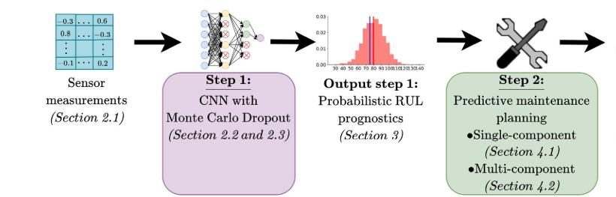
Project Structure
The project consists of four main components (Each Hyperlinked to the code on GitHub):
data_prep.py: Handles data preprocessing and preparation for training and testing.
CNN.py: Defines the Convolutional Neural Network architecture.
evaluate.py: Contains functions for model evaluation.
RUL_metrics.py: Provides custom metrics for evaluating model performance.
Docs
Contains summaries of research paper and documentation for project methodology
Data
The raw data from “Damage Propagation Modeling for Aircraft Engine Run-to-Failure Simulation”
Normalized Data
Data obtained from the authors of the research paper
Notes:
data_prep.py: Handles data preprocessing and preparation for training and testing.
CNN.py: Defines the Convolutional Neural Network architecture.
evaluate.py: Contains functions for model evaluation.
RUL_metrics.py: Provides custom metrics for evaluating model performance.

Slide 4
What is a Convolutional Neural Network
Type of deep learning model, specifically well suited for data with a grid like topology
Built from Layers:
Convolutional Layers
Apply a set filter (kernal) to the input data to create maps. Each filter is meant to detect different patterns in the data
Activation Functions:
After each convolutional layer, an activation function (typically ReLU) is applied to introduce non-linearity into the model, enabling it to learn complex patterns.
Pooling Layers:
Reduce the dimensionality of the feature maps, decreases the computational load
Fully Connected Layers
Placed at the end of the network and are used to make the final predictions. They connect neurons in one layer to every neuron in the next layer
Notes:
Type of Model: Convolutional Neural Network (CNN)
Grid-like Topology: Ideal for data with a structured, grid-like pattern, such as images.
Convolutional Layers:
Filters/Kernels: Apply filters to input data to create feature maps, each detecting different patterns.
Activation Functions:
Non-linearity: Use activation functions like ReLU after each convolutional layer to introduce non-linearity, allowing the model to learn complex patterns.
Pooling Layers:
Dimensionality Reduction: Reduce feature map size to lower computational load and prevent overfitting.
Fully Connected Layers:
Predictions: Final layers that make predictions by connecting every neuron in one layer to every neuron in the next layer.

Slide 5
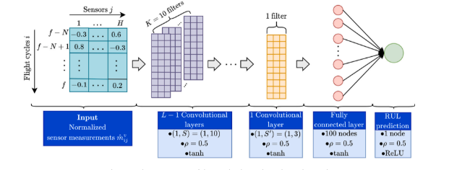

Slide 6
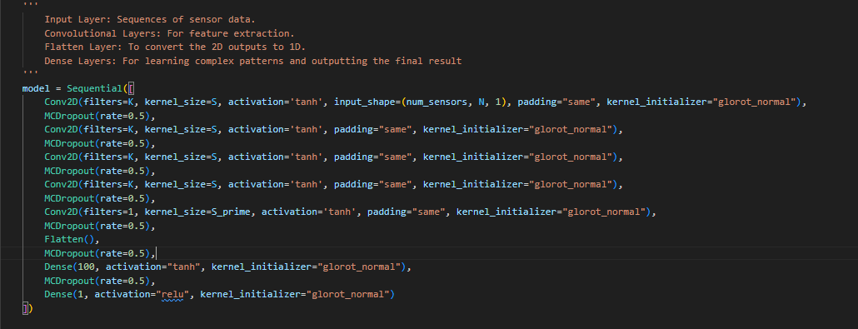
Link to code

Slide 7
CNN Architecture Key Points
Filters=k (10)
Each filter detects different features in the input data. The more filters, the more features can be captured.
Kernel_size=S (10)
Determines the spatial extent of the receptive field of the filter. (Area the filer looks at in the input data)
Activation='tanh'
Introduces non-linearity into the model, allowing it to learn more complex patterns.
Kernal_initializer=”glorot_normal”
Initializes the weights using a method designed to keep the scale of the gradients roughly the same in all layers, which helps in training deep networks more effectively.
Notes:
PADDING : Purpose: Ensures that the output feature map has the same spatial dimensions as the input by adding zero-padding around the borders. Why use tanh for activation?
Range: Outputs values between -1 and 1, making it easier for the network to learn centered and normalized data.
Non-linearity: Adds non-linearity to the model, enabling it to learn complex patterns.
Zero-centered: Helps in faster convergence during training by ensuring that the output has a mean close to zero, which helps in balancing the gradients.

Slide 8

Data Normalization
The paper highlights using this normalization -->
Different Results
Despite implementing data normalization as per the paper described, my results differed from the data I received from the authors
Resolution
After extensive troubleshooting and not being able to align the results with the paper, I decided to move forward using the dataset provided by the paper directly to ensure consistency and move forward with the project
Notes:
Issue: Implemented data normalization as described in the paper, but results did not match those provided by the authors.
Resolution:
Troubleshooting: Despite extensive troubleshooting, could not align results with the paper.
Decision: Decided to use the dataset provided directly by the paper to ensure consistency and progress with the project.

Slide 9
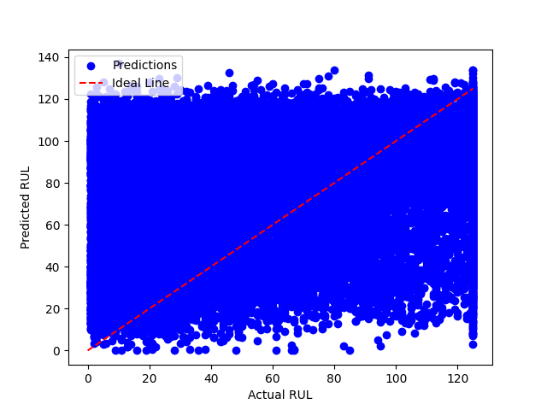
Why 2D?
At first, I had used a 1D CNN, but the results I was getting looked like this ->
Using a 2D model lets me filter across two dimensions of the input data
This is important since we are analyzing sensor data OVER TIME (our second dimension).
Notes:
Initial Approach:
1D CNN: Initially used a 1D Convolutional Neural Network.
Results: The outcomes were unsatisfactory.
Improved Approach:
2D CNN: Switched to a 2D Convolutional Neural Network.
Benefit: Allows filtering across two dimensions of the input data.
Importance: Essential for analyzing sensor data over time, as time is our second dimension.

Slide 10
MC Dropout
Purpose
Regularization technique used to prevent overfitting by randomly dropping out a fraction of the neurons during training
Rate = 0.5
In this case, 50% of the neurons are randomly set to zero during each forward pass
This forces the network to learn more robust features that do not depend on previous neurons
During Inference
In Monte Carlo dropout, dropout is applied during prediction (not just training) to create different versions of the model. By making many predictions with these versions and averaging them, we get a measure of uncertainty in the predictions. This helps understand how confident the model is about its outputs.

Slide 11
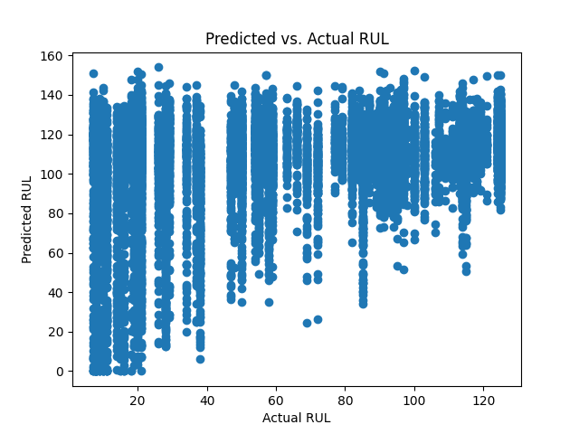
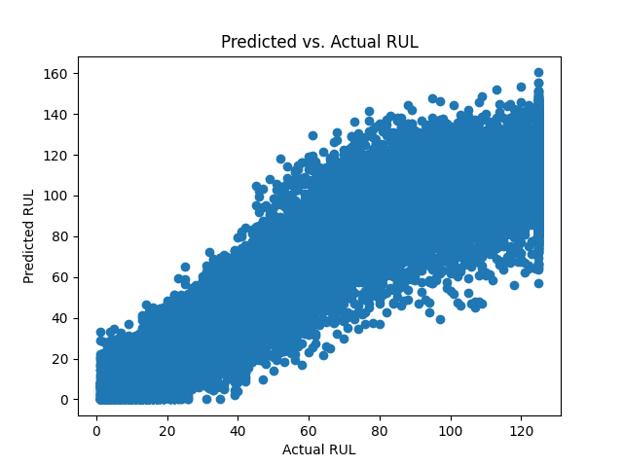
Model Failures and Refactoring
Initial Challenges
After finally getting the model to work, in testing I observed overfitting after 250 epochs, as per the original paper's guidelines.
This gave results seen here -->
Steps taken to Improve the Model
Implemented checkpoints to save the best model based on validation accuracy.
Added Early Stopping
Stopped training when no improvement was observed for a set patience.
Reduced overfitting and improved generalization as seen here -->

Slide 12
RUL Metrics
Coverage:
Definition: proportion of true Remaining Useful Life (RUL) values that fall within the credible interval defined by a specified alpha.
Importance: Coverage closer to the specified alpha value indicates better calibration.
Mean Width:
Definition: the range within which the true RUL is expected to lie with a certain probability (alpha).
Importance: Smaller widths are better for precision.
Reliability Score:
RS_total: Sum of underestimation (RS_under) and overestimation (RS_over) scores.
RS_under: Indicates minimal underestimation of uncertainty.
RS_over: Indicates minimal overestimation of uncertainty.
MW: The uncertainty of the prognostics
Importance: Lower scores indicate better reliability
Root Mean Square Error (RMSE):
Definition: This is the square root of the average of the squared differences between the predicted and actual RUL values.
Importance: It provides a measure of how well the model’s predictions match the true values, with lower values indicating more accurate predictions.
Mean Absolute Error (MAE):
Definition: This measures the average variance of the predicted RUL distributions across all instances. Variance quantifies the spread of the predictions around their mean.
Importance: ower mean variance indicates more consistent predictions, meaning the model’s predictions do not vary widely from one run to another.

Slide 13
Key Metrics
Engine Set | Highest α-MW Which level | Coverage α = .50 | Coverage α = .90 | Coverage α = .95 | RMSE | MAE
FD001 | 34.71: α = 0.95 | 0.5200 | 0.9000 | 0.9000 | 12.939 | 9.913
FD002 | 36.14 α = 0.95 | 0.4671 | 0.8185 | 0.8185 | 14.177 | 10.785
FD003 | 39.84: α = 0.95 | 0.4700 | 0.9000 | 0.9000 | 13.056 | 10.385
FD004 | 38.85 α = 0.95 | 0.4274 | 0.8104 | 0.8104 | 15.970 | 12.005
Paper’s (best result) | 47.6: FD003 α = 0.95 | 0.51 | 0.91 | 0.85 | 13.72 | N/A
Notes:
In general, the 𝛼-Coverage is close to 𝛼 for all subsets and all
the considered values for 𝛼 (see Table 4). This means that the predicted probabilities match well with the observed outcomes, and the
RUL prognostics are thus reliable. However, the mean widths of the
confidence interval are quite large, as also observed in Fig. 4. The
uncertainty of the RUL prognostics is thus large, despite the reliability
of the prognostics.

Slide 14
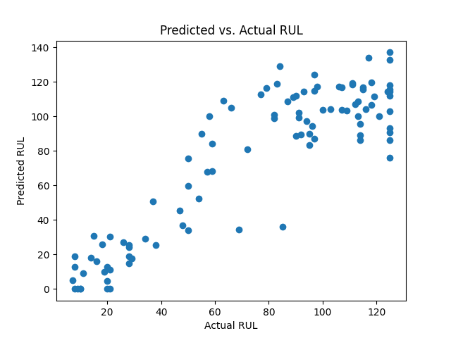

Slide 15
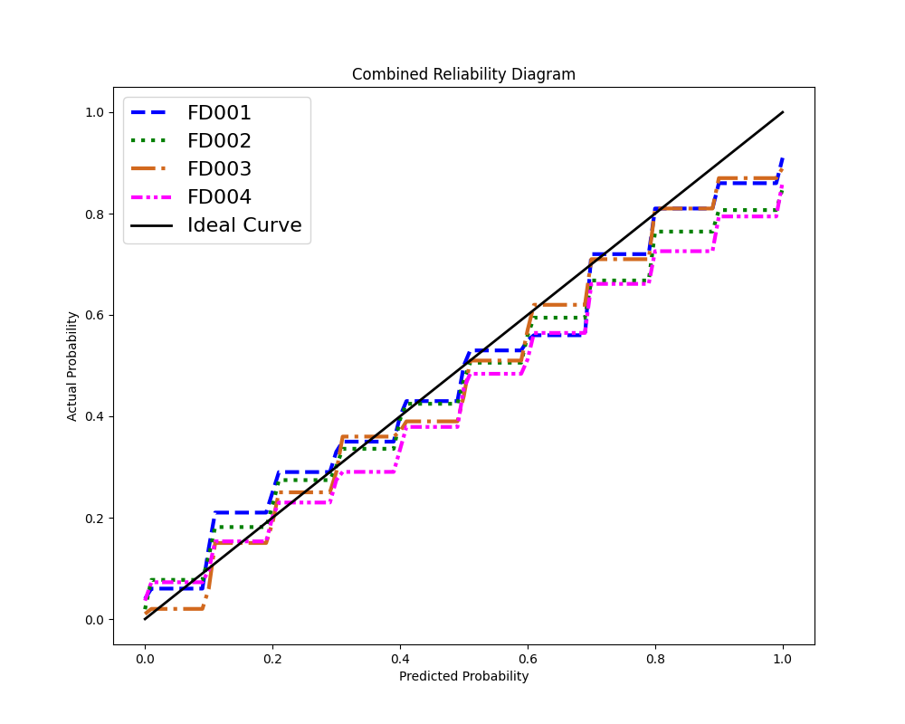
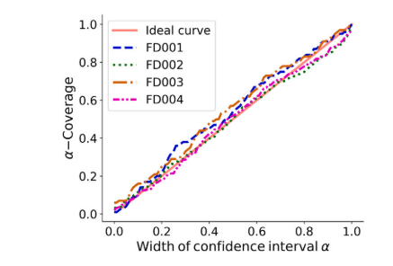
My Results Paper Results
Notes:
Why the Staircase Pattern Appears:
Discrete Binning:
Method: Predictions are divided into distinct bins based on their value ranges.
Effect: Each bin is assigned a uniform reliability score, creating horizontal steps on the graph.
Cumulative Scoring:
Method: Reliability scores accumulate over the bins, showing the aggregate reliability.
Effect: As more predictions are included, the score steps up, forming a staircase.
Rounded or Truncated Values:
Method: Reliability scores might be rounded or truncated to certain decimal places.
Effect: This rounding creates distinct levels rather than a continuous line, enhancing the staircase effect.

Slide 16
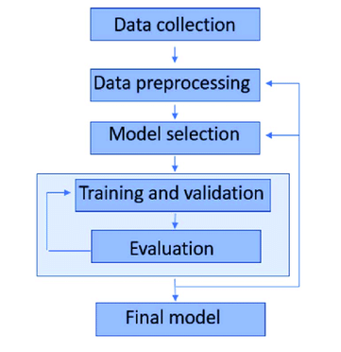
Real World Uses
Adaptation to Different Machinery:
The techniques and methods used here can be applied to evaluate the RUL of any component of machinery.
This approach can be extended to something more comprehensive, such as a full-body system like a tank.
Configuring Input Shape:
For this to work, the input shape must be configured for the new number of useful sensor readings.
The rest of the code and methodology can stay the same, ensuring a scalable and adaptable solution.

Slide 17


